Slide 1
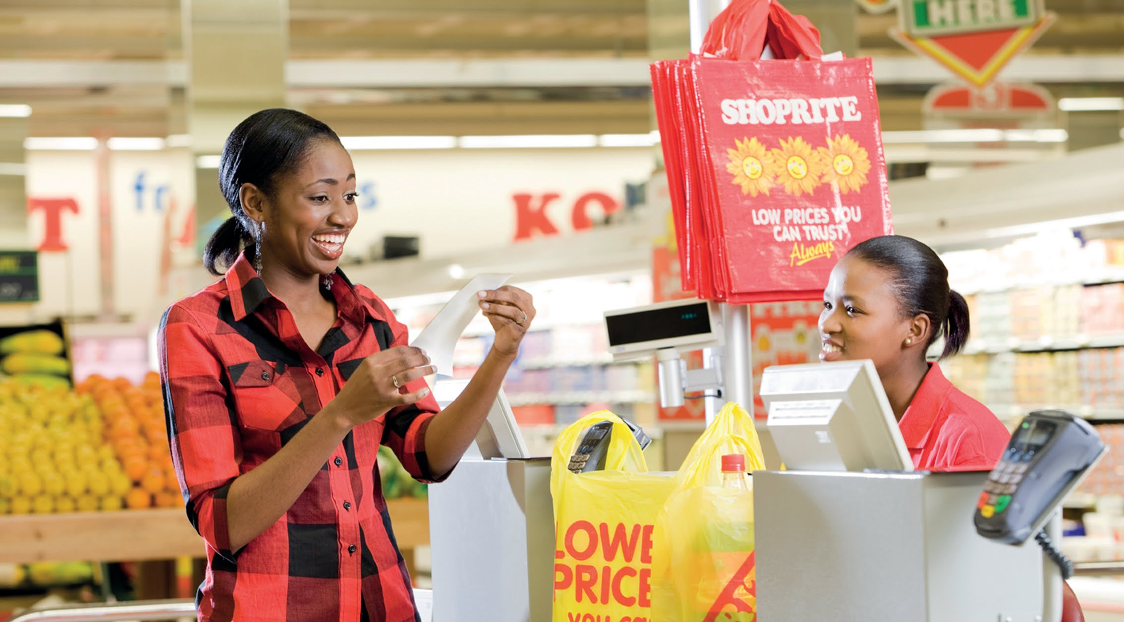
Project Approval Committee (PAC)
7 April 2021
Document has been replaced and converted to Google Slides. The latest version must be updated, and can be found here. Please contact Celeste if you do not have access to edit / view.
https://drive.google.com/drive/u/0/folders/1wh9D-f3-X-v-ncX2vqnJxGxRGuMoMWuH
Project Concept Approval
5665-Distributed Order Management POC
Sponsor: Pieter Engelbrecht
Business Owner: Mark Cotton/ Wim Van Aalst

Slide 2
Description of the Project
Describe the Project / what we want to do
This project will implement a Proof of Concept for key aspects of a Distributed Order Management (DOM) solution. This is a key component of the future Shoprite e-commerce enterprise architecture and the supply chains required to support this. A DOM optimizes fulfillment based on pre-defined business rules where there are multiple sources of inventory and fulfillment channels.
The approach will be to select a DOM technology and implement key capabilities as a Proof of Concept in one BU. Current thinking is that this would be in Furniture which has 2 brands and multiple stock-holding locations, with potential for drop-ship from Suppliers.
Justify why we want to do this project
A key aspect of the future enterprise e-commerce architecture and supporting supply chain will be the capability to orchestrate orders from multiple front-ends, determine inventory availability and decide on the optimum fulfilment source and mechanism.
As the enterprise e-commerce platform extends to multiple BUs and product ranges, this will become a vital capability to ensure customer expectations are met in the most cost-effective way. It is envisaged that by the end of 2022 this will emerge as a critical business requirement.
The DOM Proof of Concept will enable Shoprite to gain insight into how the DOM capability can best be deployed in the Shoprite context and will help determine the roadmap for further development and roll-out of DOM capabilities.

Slide 3
Costs and Benefits
Estimated 5 Year Total Cost of Ownership Category (Indicate with ✔️)
R1 mil to R10 mil | R10 mil to R50 mil | R50 mil to R100 mil | R 100+ mil
✔️
Return on Investment Expected? | ✔️or ❌
If ROI = ✔️, provide Indicative Tangible Benefits below
Operational Cost Saving (pa) | R xxx,xxx,xxx
Capital Cost Saving | R 0
Revenue Increase (pa) | Revenue increase will be realised by each business unit utilising the platform built
If ROI =❌, provide Details below
Audit Finding
Legislation (specify)
Other (Why we need to do it?)
Amount Required for Investigation (Indicate with ✔️) |  | Investigation Approved ✔️or ❌?
Under R500k | 500k to R1 mil | R1 mil to R1.5 mil | R 1.5+ mil
✔️

